Slide 1
Predictiong “Sour” Odorant Characters using Molecular Properties
Final Project-Introduction to Machine Learning for Neuroscience
Yonatan Goldstein
Ofir Sade
03/2022

Slide 2
The Dataset
Keller and Vosshall (2016), tested the olfactory perception of 480 structurally and perceptually diverse molecules at two concentrations using a panel of 55 healthy human subjects.
For each stimulus, they collected data on perceived intensity, pleasantness, and familiarity. In addition, subjects were asked to apply 20 semantic odor quality descriptors to these stimuli and were offered the option to describe the smell in their own words.

Slide 3
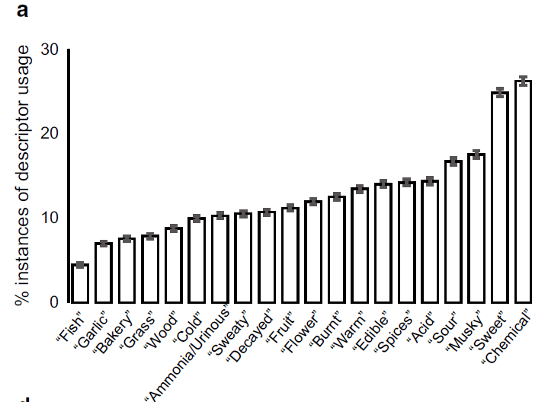
Target Variable
a Descriptor usage for all subjects. 100 % would correspond to a descriptor assigned to all stimuli by all subjects.

Slide 4
Target Variable
Chacko et al (2020), used Keller’s dataset to predict the odorant characters of “sweat” and “musky”.
The three most frequently used semantic descriptors among the 55 subjects were considered to be the odor quality labels for a given compound. Therefore, each odorant was represented by three odor characters associated with it.

Slide 5
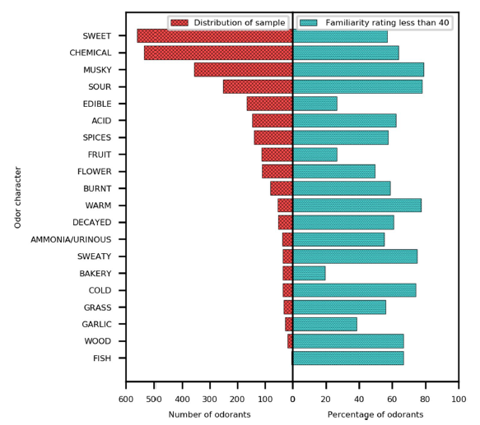
Target Variable
Distribution of samples associated with the odor character (left) and the percentage of odorants given low familiarity ratings by the subjects for each odor character (right).

Slide 6
Target Variable
Keller and Vosshall (2016), concluded that the descriptor “chemical” was used often when the subjects were unfamiliar with the smell. Which is supported by the observation that 63.7% compounds perceived to have “chemical” OC are rated to be unfamiliar by the majority of the subjects.
In this light, we concluded to predict the odorant character “sour”.

Slide 7
Target Variable
Unlike, Chacko et al (2020), we took into consideration subject’s actual rating of each OC, and not just the frequency of ratings.
We calculated the mean rating, regarding NaN as zeros, for each combination of odor and odor dilution.
For every combo of odor and dilution, we tested If the 3 highest means included “sour”- regarded as 1, on didn’t include “sour”- regarded as 0.

Slide 8
Molecular Descriptors
In order to predict our target variable, we used molecular descriptors generated by RDKit_2D.
X was composed of 960 rows of odor and dilution combos.
y contained each row ‘ground truth’ label- 1 for “sour”, 0 for non-”sour”.

Slide 9
Preprocessing
Empty columns were removed.
Non-numeric columns were dropped.
NaN’s were filled with column mean.

Slide 10
EDA
X.info()
X.describe()
Printing data chunks
<class 'pandas.core.frame.DataFrame'>
Int64Index: 960 entries, 0 to 959
Columns: 178 entries, CID to fr_unbrch_alkane
dtypes: float64(100), int64(78)
memory usage: 1.3 MB

Slide 11
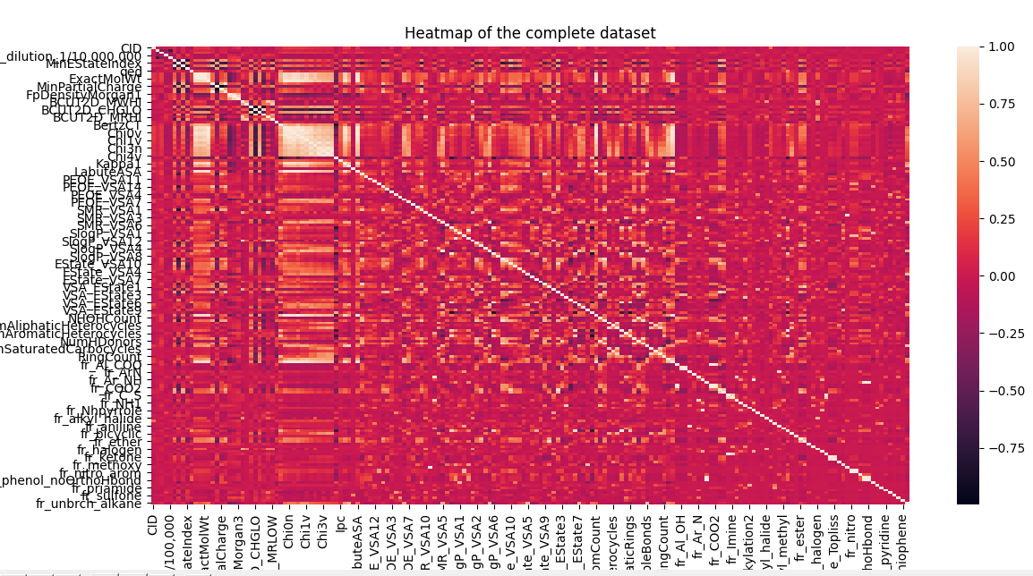
Correlations Heatmap

Slide 12
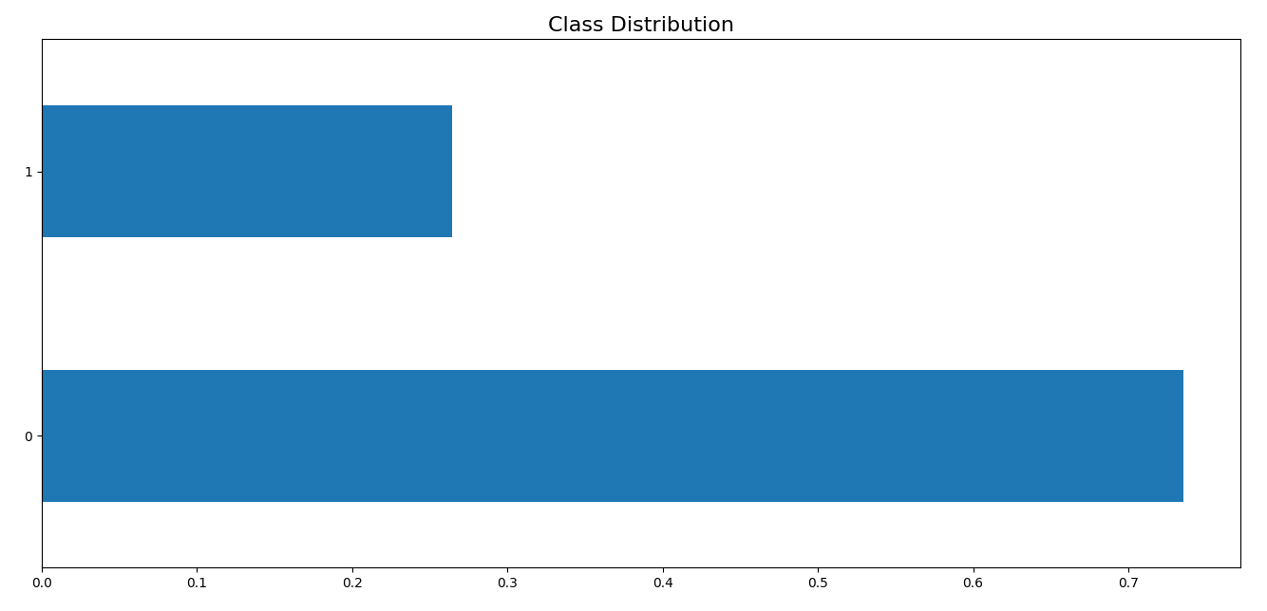
Class Distribution

Slide 13
Train Test Split
Due to the unbalanced class distribution, we preformed a stratified train test split, with test size of 10%.

Slide 14
Pipeline
We used Imblearn pipeline, for model development.
Pipeline allowed us to preform different steps only on the training set in each CV, without data leakage from the validation set.
We used stratified K-fold, to count for the imbalance of the classes.

Slide 15
Pipeline
In each CV we: 1) scaled the data using standard scalar. 2) over-sampled using ADASYN to count for the imbalance of the classes. 3) searched for the optimal model using gridsearchCV for hyperparameter tuning.

Slide 16
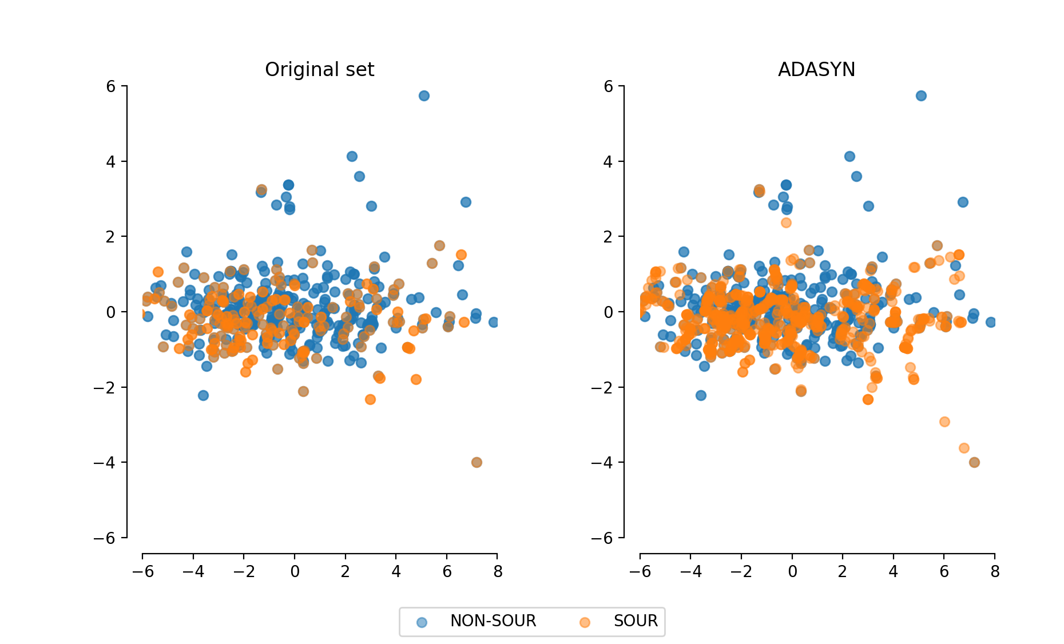
Oversampling Using ADASYN

Slide 17
Classifiers
We tested 4 classifiers, with different parameters for each one of them:
1) Random Forest
2) SVM
3) Logistic regression
4) XGBoost

Slide 18
Optimal model
The optimal model, using the complete dataset was:
{'classifier': LogisticRegression(C=100, max_iter=10000, random_state=42, solver='liblinear'), 'classifier__C': 100, 'classifier__penalty': 'l2', 'classifier__solver': 'liblinear'}
The f1 score of the model on training data was:
0.4789
The f1 score of the model on test data was:
0.5143

Slide 19
Classification Report
precision recall f1-score support
0 0.86 0.62 0.72 71
1 0.40 0.72 0.51 25
accuracy 0.65 96
macro avg 0.63 0.67 0.62 96
weighted avg 0.74 0.65 0.67 96

Slide 20
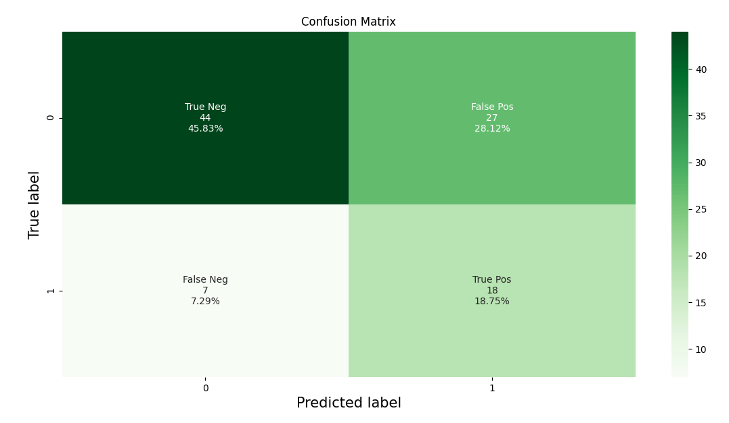
Confusion Matrix

Slide 21
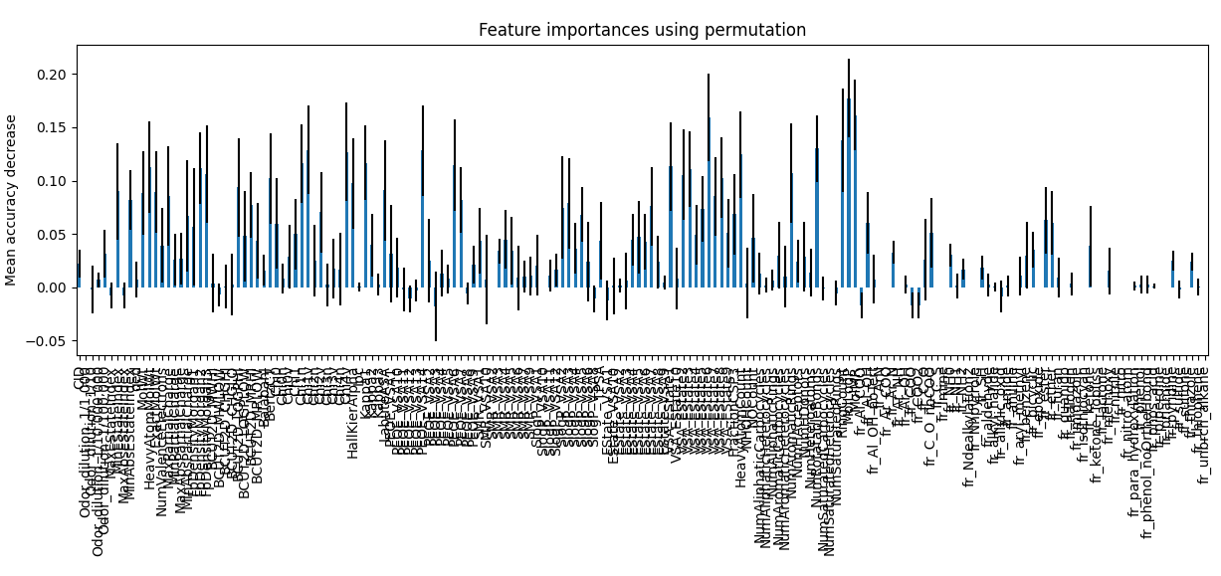
Feature Permutation Importance

Slide 22
Sorted Feature Permutation Importance
MolLogP 0.177 +/- 0.037
MolMR 0.161 +/- 0.033
VSA_EState6 0.159 +/- 0.041
RingCount 0.138 +/- 0.048
NumRotatableBonds 0.130 +/- 0.031
Chi1v 0.129 +/- 0.041
PEOE_VSA14 0.128 +/- 0.042
Chi4v 0.127 +/- 0.046
HeavyAtomCount 0.124 +/- 0.041
Kappa1 0.117 +/- 0.035
Chi1n 0.116 +/- 0.037
PEOE_VSA6 0.114 +/- 0.043
VSA_EState1 0.113 +/- 0.041
HeavyAtomMolWt 0.113 +/- 0.043
FpDensityMorgan2 0.112 +/- 0.034

Slide 23
Feature Selection
We used Boruta for feature selection.
Features in the green area:
['MinEStateIndex', 'BCUT2D_MRLOW', 'BalabanJ', 'Chi4n', 'MolMR’]
Features in the blue area:
[]

Slide 24
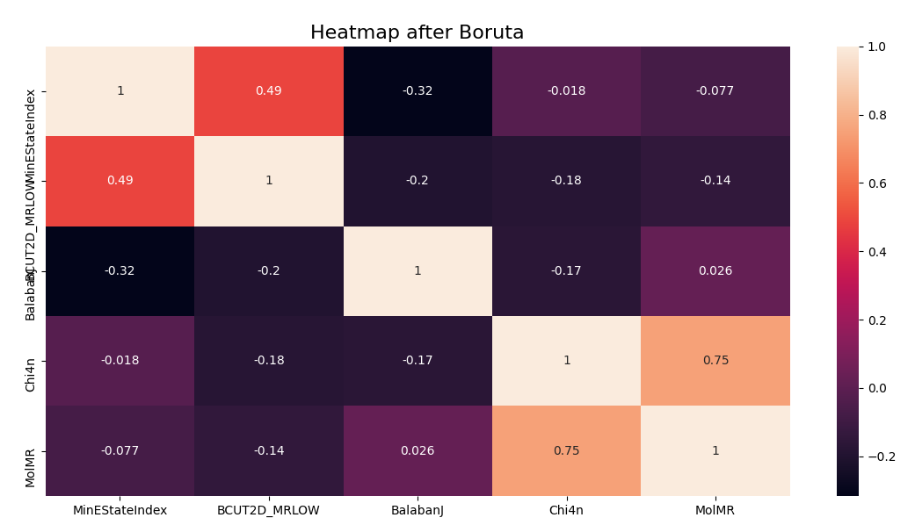
Heatmap After Boruta Feature Selection

Slide 25
Optimal Model After Boruta
{'classifier': XGBClassifier(base_score=None, booster=None, colsample_bylevel=None,
colsample_bynode=None, colsample_bytree=None,
enable_categorical=False, eval_metric='logloss', gamma=0.1,
gpu_id=None, importance_type=None, interaction_constraints=None,
learning_rate=1, max_delta_step=None, max_depth=5,
min_child_weight=6, missing=nan, monotone_constraints=None,
n_estimators=10, n_jobs=None, num_parallel_tree=None,
predictor=None, random_state=None, reg_alpha=0.1, reg_lambda=100,
scale_pos_weight=None, seed=42, subsample=None, tree_method=None,
use_label_encoder=False, validate_parameters=None, ...), 'classifier__gamma': 0.1, 'classifier__learning_rate': 1, 'classifier__max_depth': 5, 'classifier__min_child_weight': 6, 'classifier__n_estimators': 10, 'classifier__reg_alpha': 0.1, 'classifier__reg_lambda': 100}

Slide 26
Optimal Model After Boruta
After Boruta
Before Boruta
The f1 score of the model on training data was:
0.4858
The f1 score of the model on test data was:
0.5333
The f1 score of the model on training data was:
0.4789
The f1 score of the model on test data was:
0.5143

Slide 27
Classification Report After Boruta
precision recall f1-score support
0 0.85 0.73 0.79 71
1 0.46 0.64 0.53 25
accuracy 0.71 96
macro avg 0.65 0.69 0.66 96
weighted avg 0.75 0.71 0.72 96

Slide 28
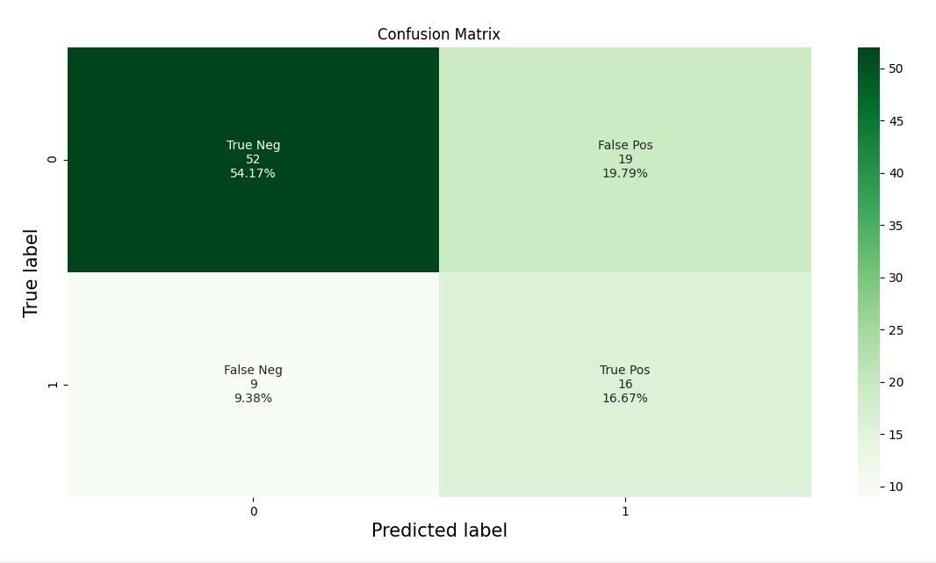
Confusion Matrix After Boruta

Slide 29
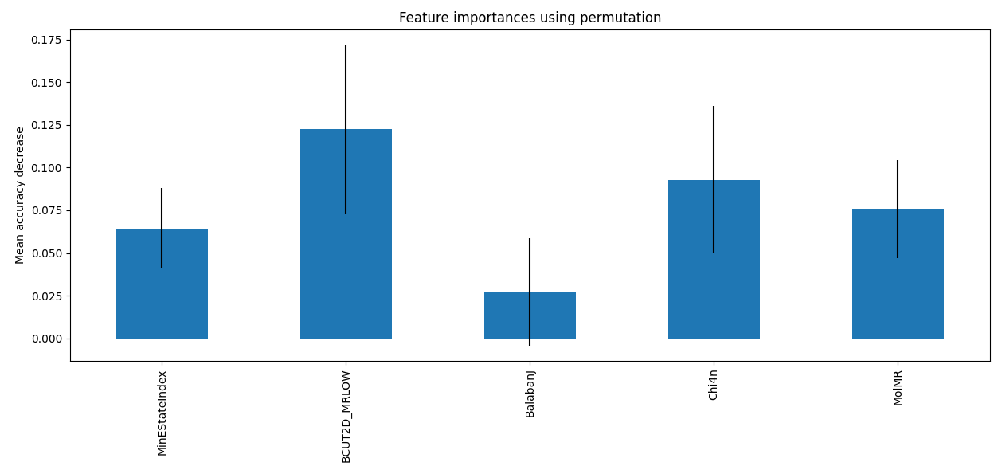
Feature Importance After Boruta

Slide 30
Feature Importance After Boruta
BCUT2D_MRLOW 0.122 +/- 0.050
Chi4n 0.093 +/- 0.043
MolMR 0.076 +/- 0.029
MinEStateIndex 0.064 +/- 0.024

Slide 31
Features Descriptions
BCUT2D_MRLOW- Unspecified.
Chi4n- Molecular connectivity index.
MolMR - Wildman-Crippen Molar Refractivity value; captures the polarizability of the molecules.
MinEStateIndex- Minimum E-State value.

Slide 32
References
Keller, A., & Vosshall, L. B. (2016). Olfactory perception of chemically diverse molecules. BMC neuroscience, 17(1), 1-17.‏
Chacko, R., Jain, D., Patwardhan, M., Puri, A., Karande, S., & Rai, B. (2020). Data based predictive models for odor perception. Scientific reports, 10(1), 1-13.‏

Slide 33
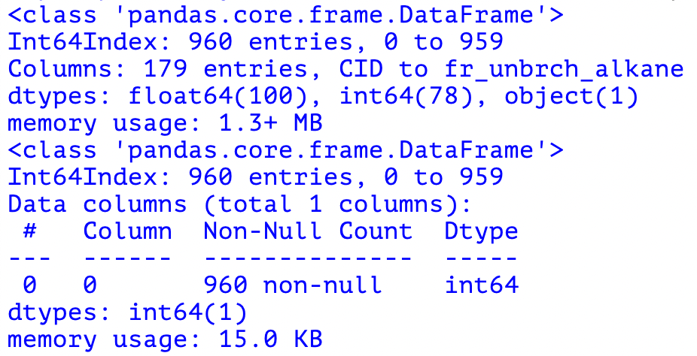
Preprocessing
Initially, we needed to organise the data and match the relevant subjects’ evaluations to the odour’s moleular descriptors.
For this purpose, we translated the substances’ CIDs to SMILES and merged the evaluations to the relevant molecular descriptors.
We decided to label each observation in the following manner:
Firstly, we calculated the average score each substance got in each possible odour descriptor (edible, sweet, fish, garlic, spices, cold, sour, etc…).
We then picked the 3 descriptors with the highest average and that list was used to create the label.
If this list contained the ‘sour’ descriptor, we considered it as sour (1).

Slide 34
Feature Selection
BORUTA
In order to find the best choice of features from the dataset we decided to use Boruta which was used in Chacko et. al, 2020.
Correlations Matrix (Pearson/Spearman)
After Choosing the features with the highest importance according to Boruta, we generated a Pearson correlations heatmap, in which we would expect to see whether any of the remaining features are redundant due to high correlation.
This step was carried out for each model we considered; the results will be discussed later on.

Slide 35
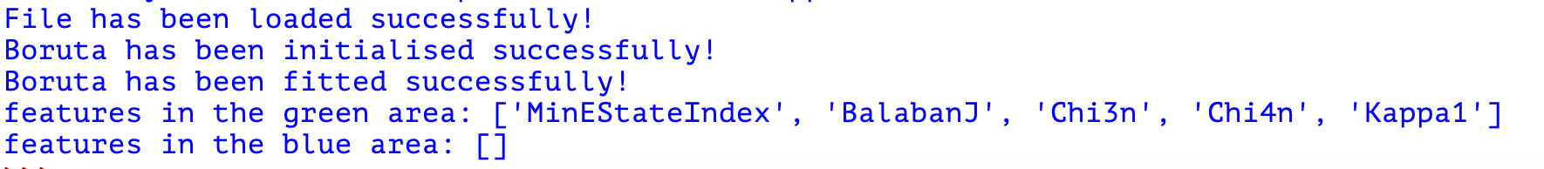
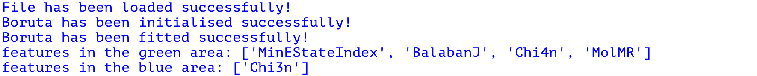

Slide 36
Oversampling with ADASYN Introduction
Due to the relative lack of data categorised as sour in comparison with data not categorised as sour, we decided to use ADASYN for oversampling of the minority group (odours categorised as sour).
ADASYN essentially creates a sufficient amount of synthetic data from the minority group of the data in an effort to even out the types of data the model learns from so the learning process may be less skewed.

Slide 37
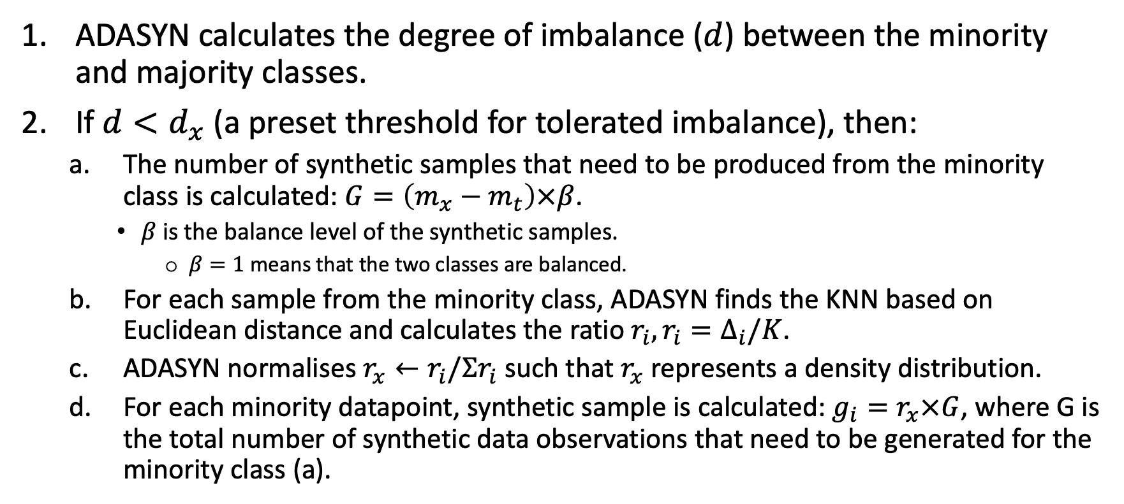
Oversampling with ADASYN – Practical Steps (I)
ADASYN calculates the degree of imbalance ($d$) between the minority and majority classes.
If $d<d_{x}$ (a preset threshold for tolerated imbalance), then:
The number of synthetic samples that need to be produced from the minority class is calculated: $G=\left(m_{x}−m_{t}\right)×β$.
$β$ is the balance level of the synthetic samples.
$β=1$ means that the two classes are balanced.
For each sample from the minority class, ADASYN finds the KNN based on Euclidean distance and calculates the ratio $r_{i}, r_{i}=Δ_{i}/K$.
ADASYN normalises $r_{x}←r_{i}/Σr_{i}$ such that $r_{x}$ represents a density distribution.
For each minority datapoint, synthetic sample is calculated: $g_{i}=r_{x}×G$, where G is the total number of synthetic data observations that need to be generated for the minority class (a).

Slide 38
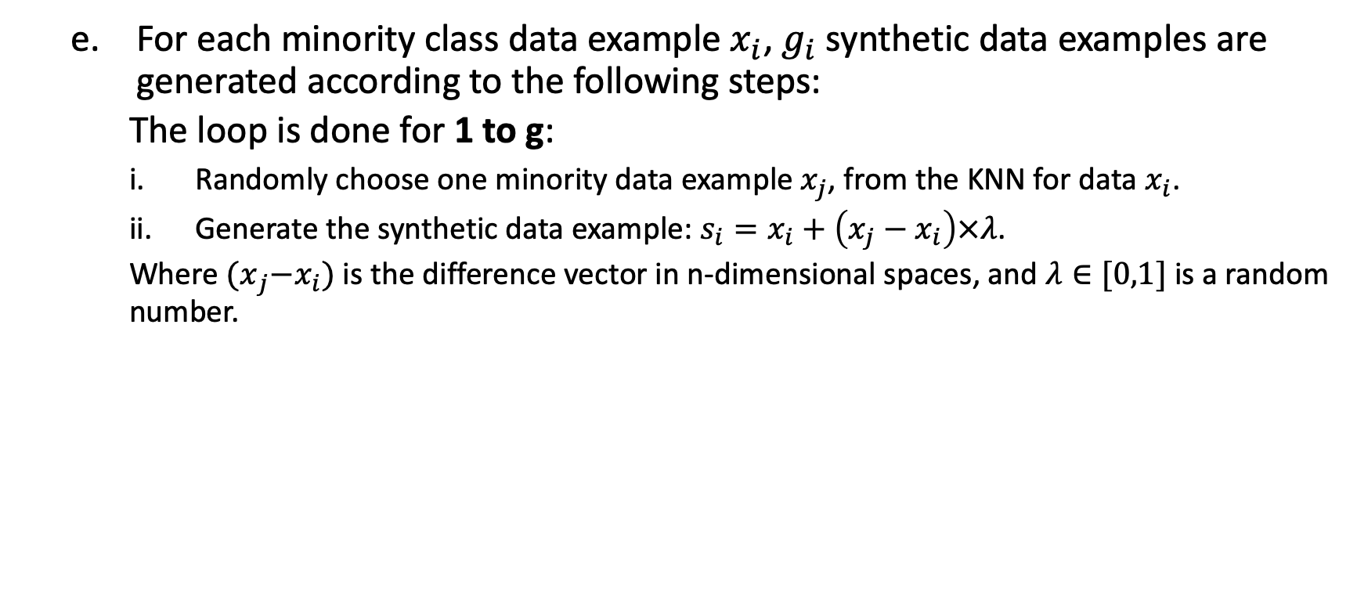
Oversampling with ADASYN – Practical Steps
For each minority class data example $x_{i}$, $g_{i}$ synthetic data examples are generated according to the following steps:
The loop is done for 1 to g:
Randomly choose one minority data example $x_{j}$, from the KNN for data $x_{i}$.
Generate the synthetic data example: $s_{i}=x_{i}+\left(x_{j}−x_{i}\right)×λ$.
Where ${(x}_{j}−x_{i})$ is the difference vector in n-dimensional spaces, and $λ∈[0,1]$ is a random number.

Slide 39
Model Selection
We considered the following supervised-learning models:
Random Forest Classifier
SVM
XGBoost
Logistic Regression
K-Fold Cross-Validation
We used 5-Fold Cross-Validation to avoid overfitting of the trained model.
We implemented this using GridSearchCV.

Slide 40
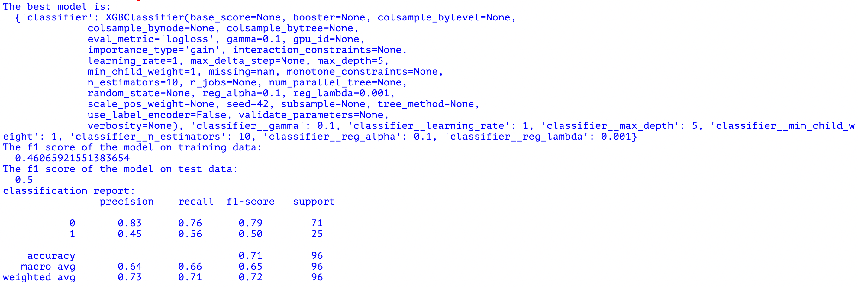
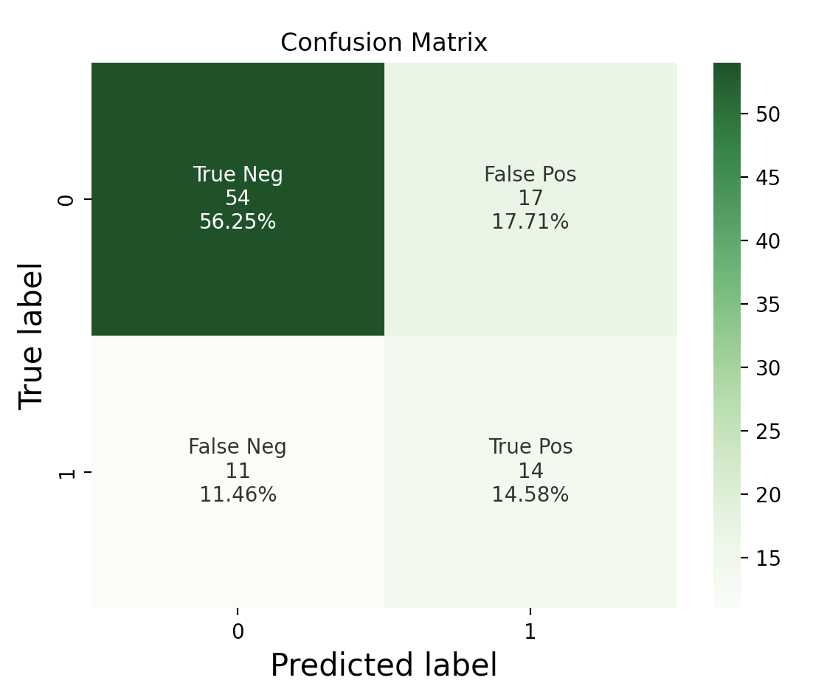
Confusion Matrices Before BORUTA (Feature Selection)

Slide 41
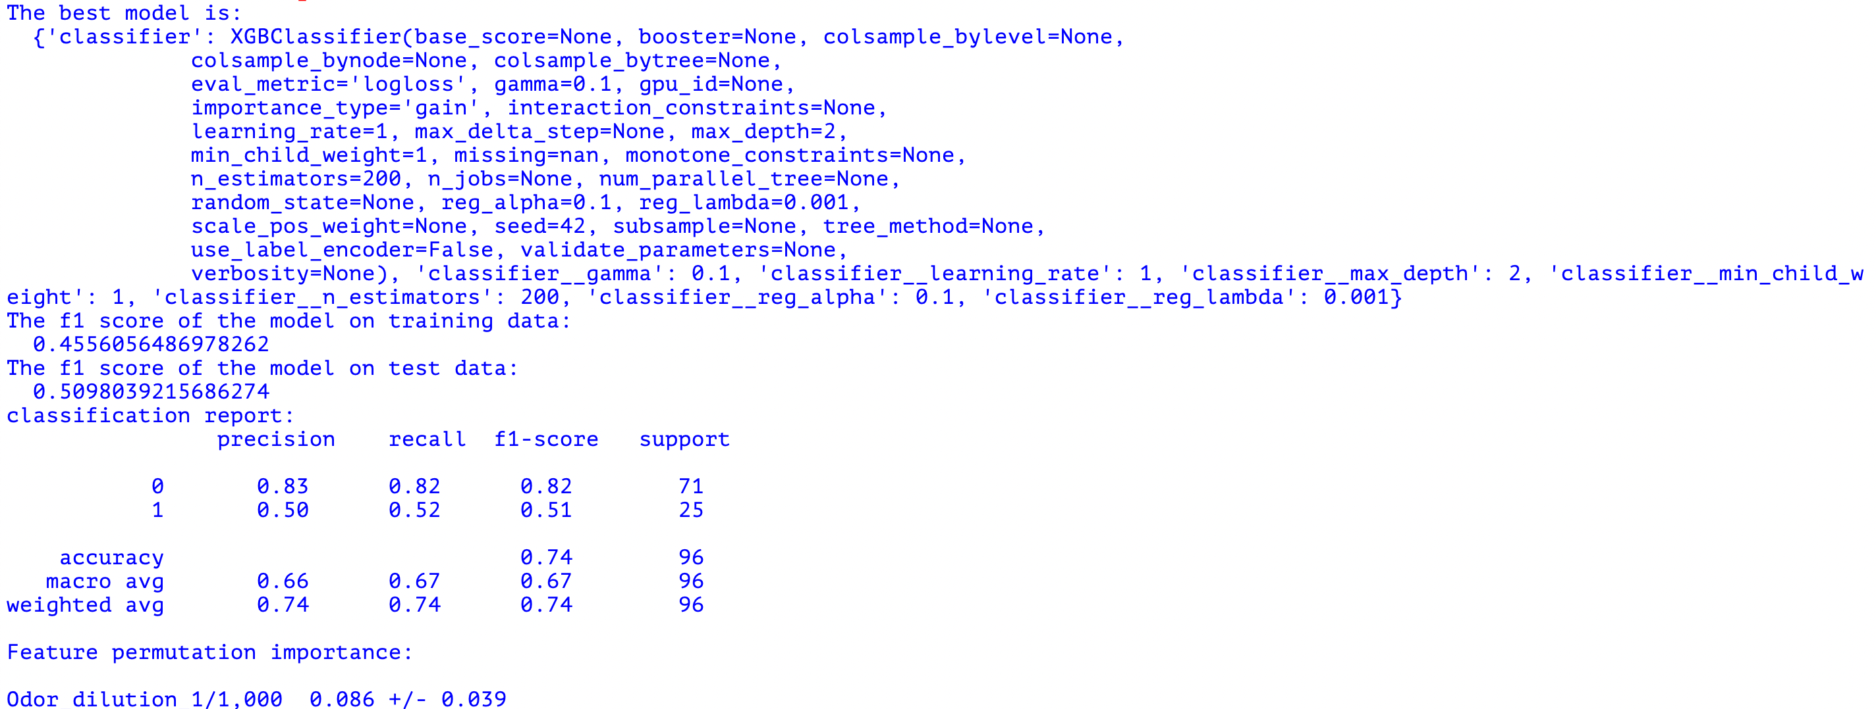
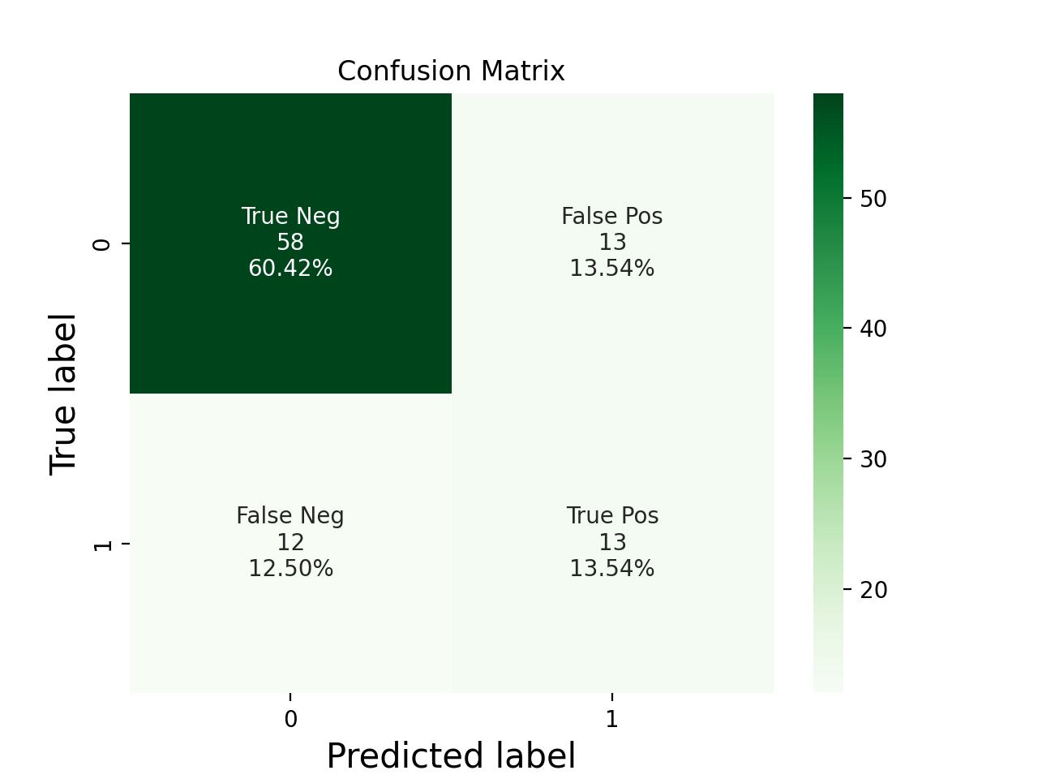
Confusion Matrices Before ADASYN (Oversampling)

Slide 42
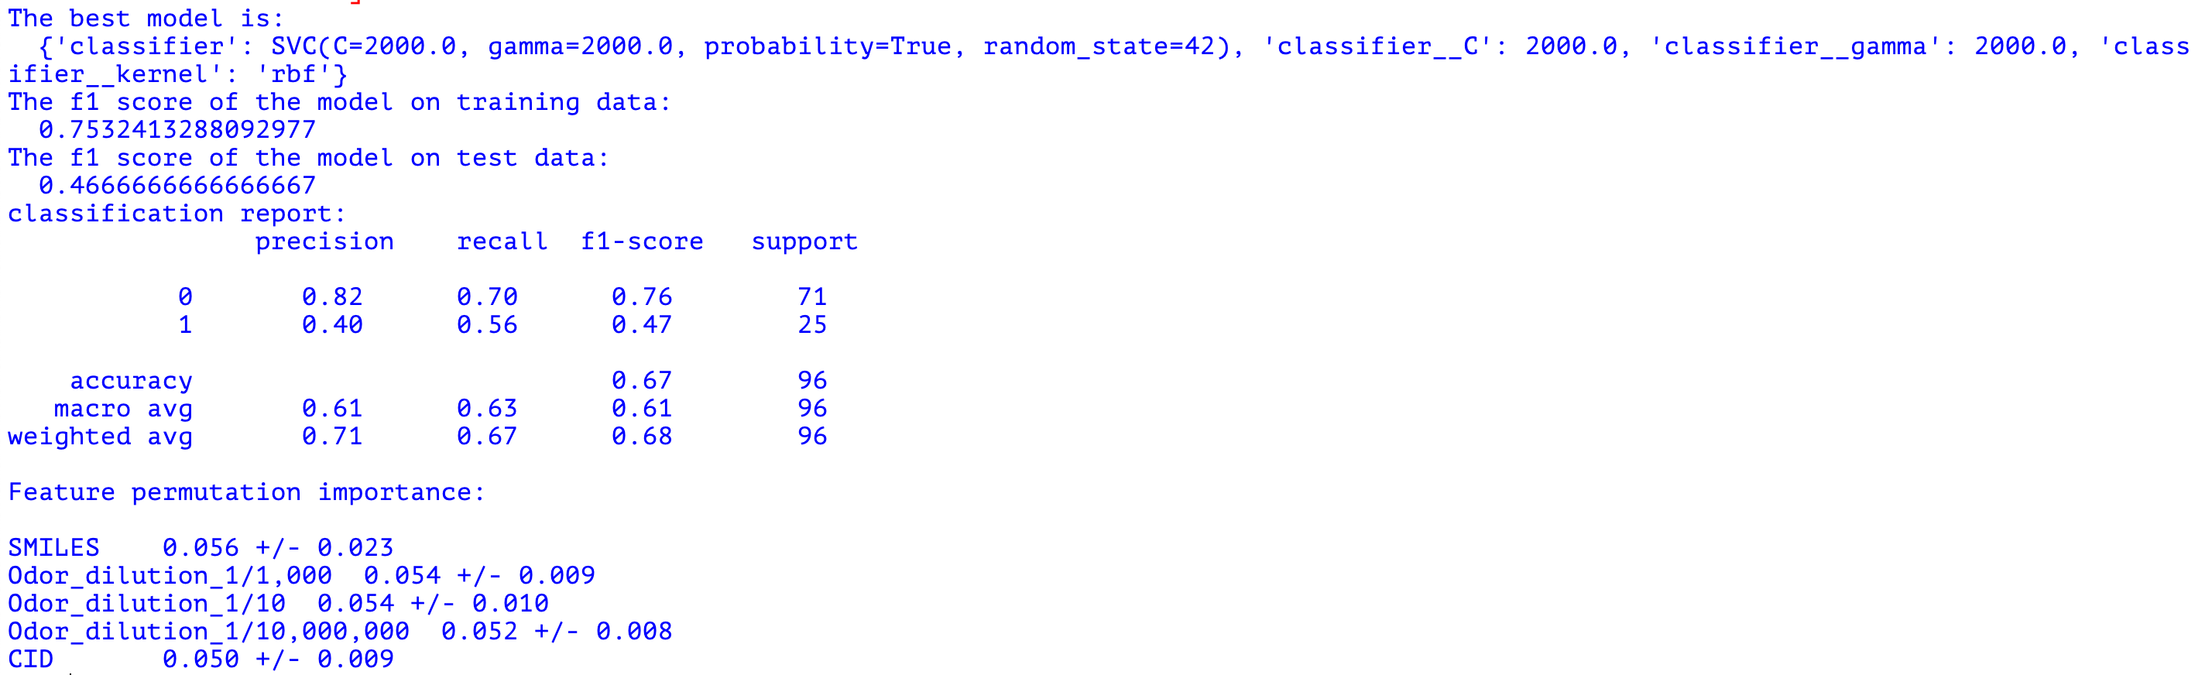
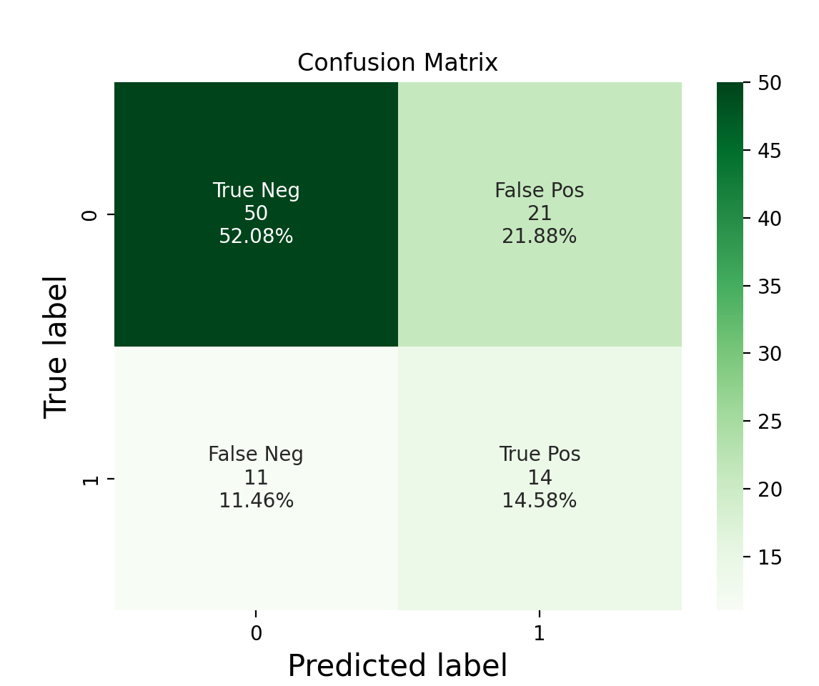
Confusion Matrices After Boruta & ADASYN

Slide 43
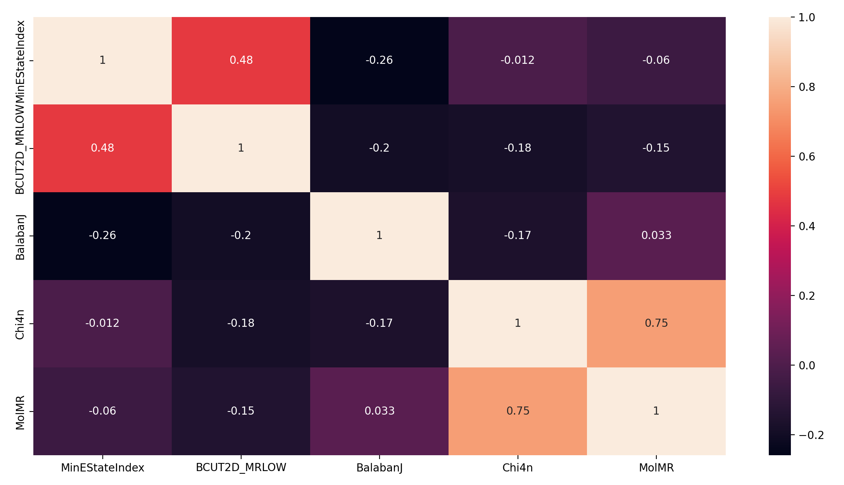
Feature Correlation After Boruta & Scaling
Notes:
The only ones with a very high correlation are Chi4n and MolMR…. Maybe we should consider dropping one of them?

Slide 44
The Final Model’s Performance Evaluation
F1 score (on the test set): 0.51
Accuracy: 0.74
Precision (weighted average): 0.74
Recall (weighted average): 0.74

Slide 45
Conclusions
Our initial “gut feeling” was that oversampling, more specifically ADASYN, would be a useful tool since the amount of “sour” substances are scarce in comparison with “non-sour” substances.
This was disproven by our results in most models, and specifically in our selected, optimal, model.
We found the optimal model to be SVM, with the addition of Boruta for feature selection.

Slide 46
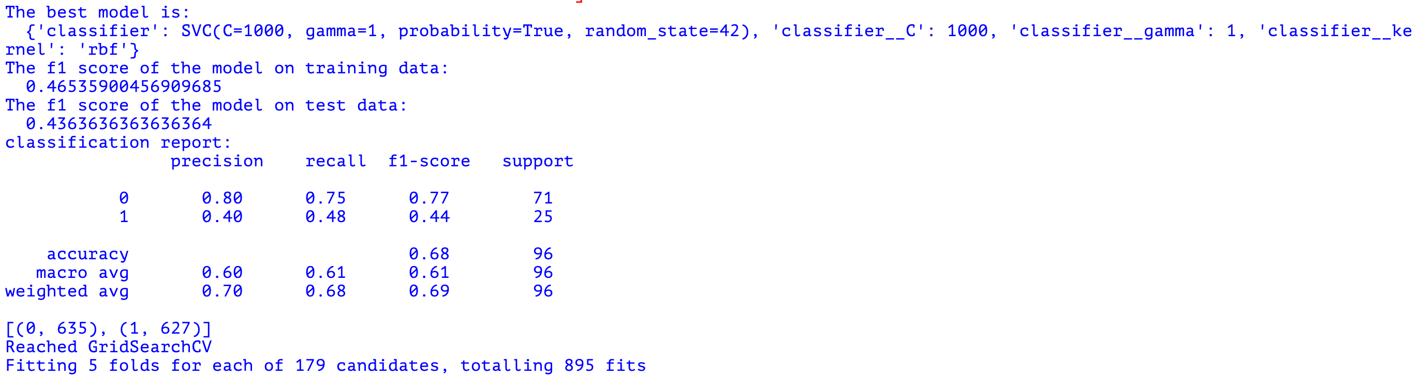
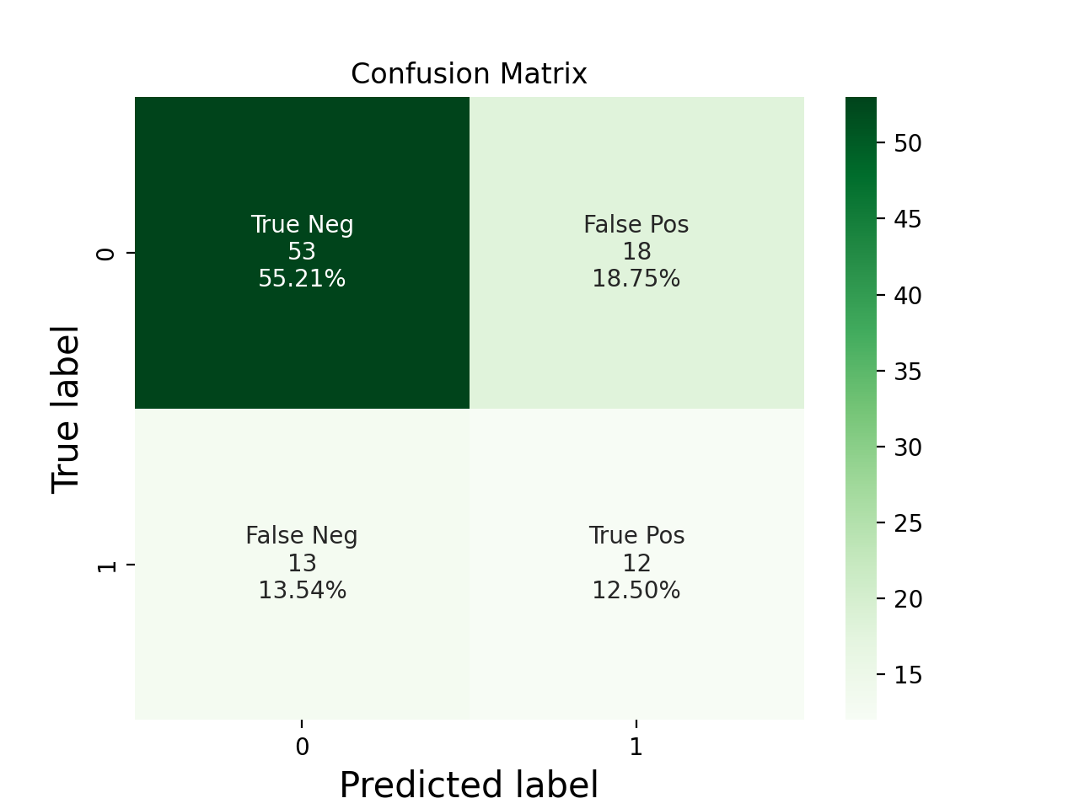
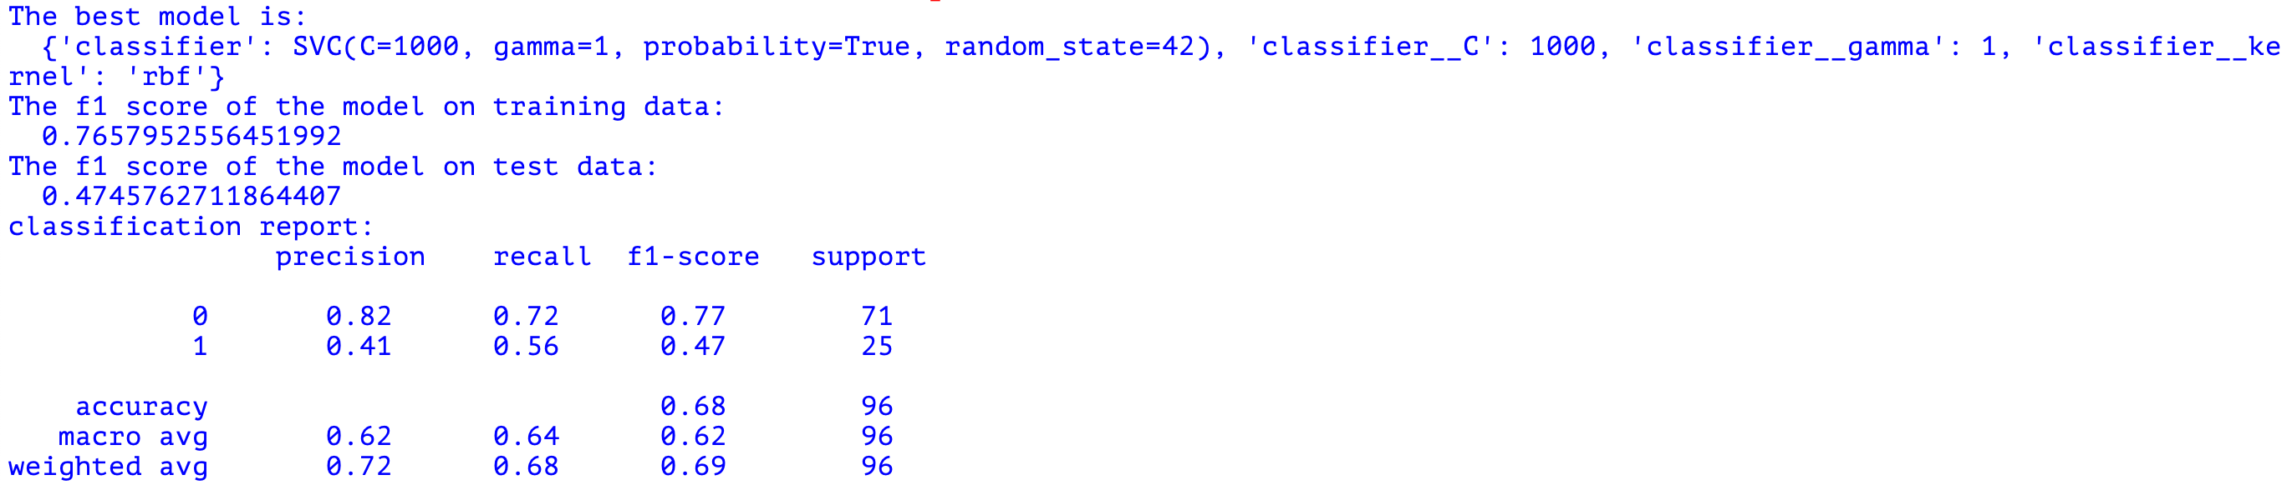

Notes:
SVM with my parameters

Slide 47
Notes:
SVM with Yonatan’s parameters

Slide 48
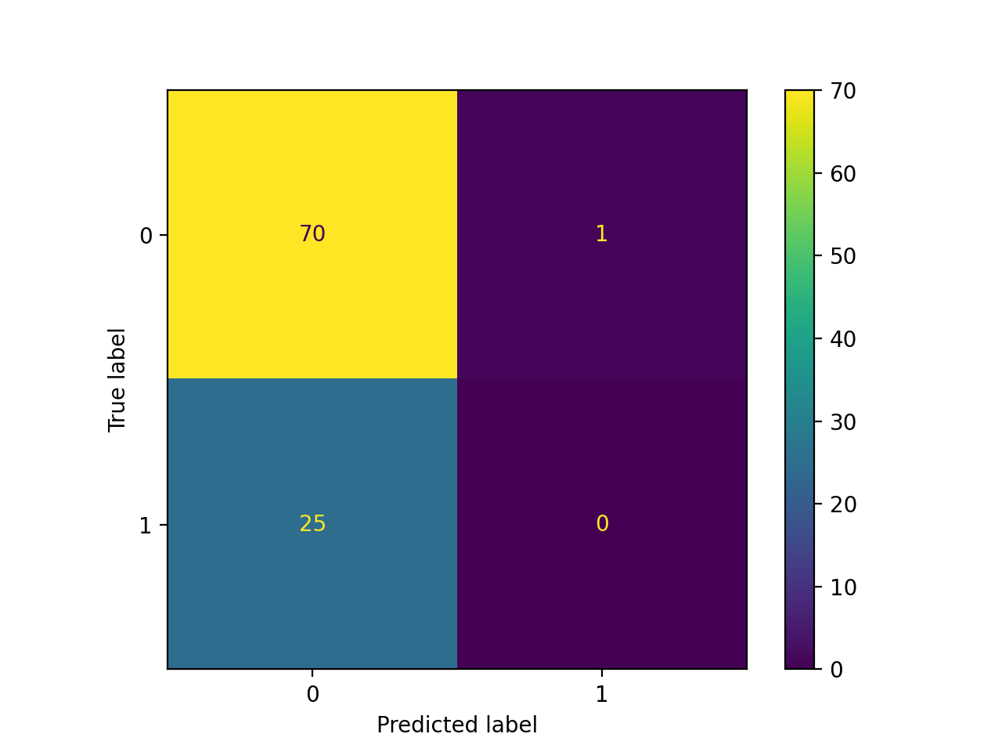
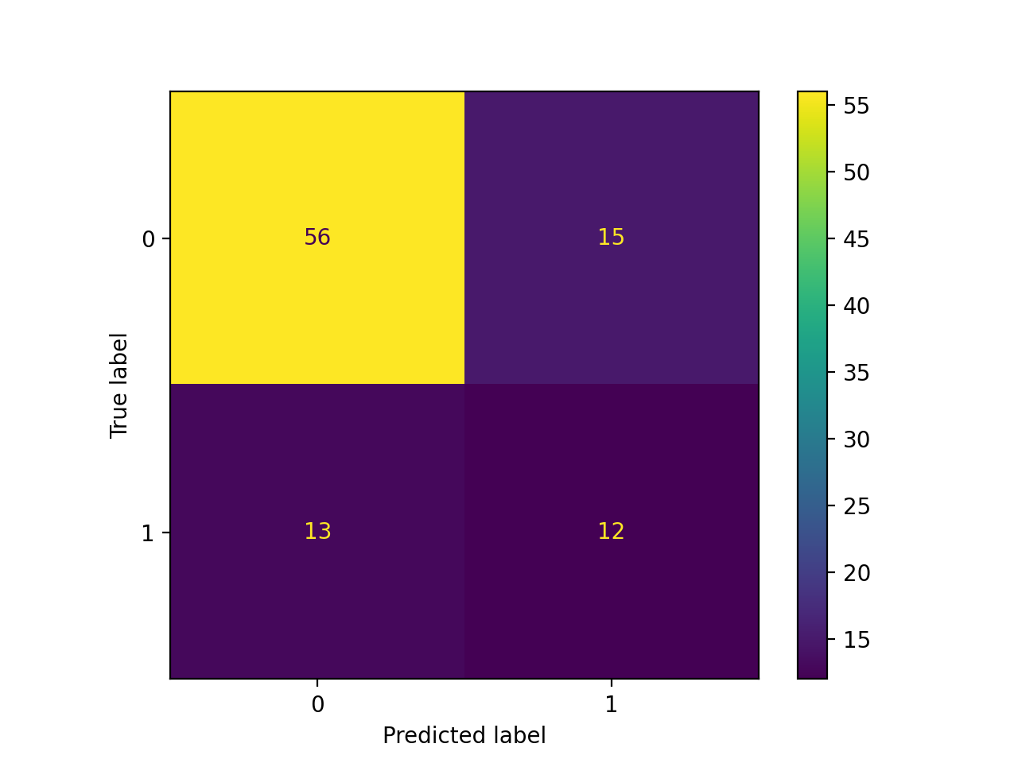
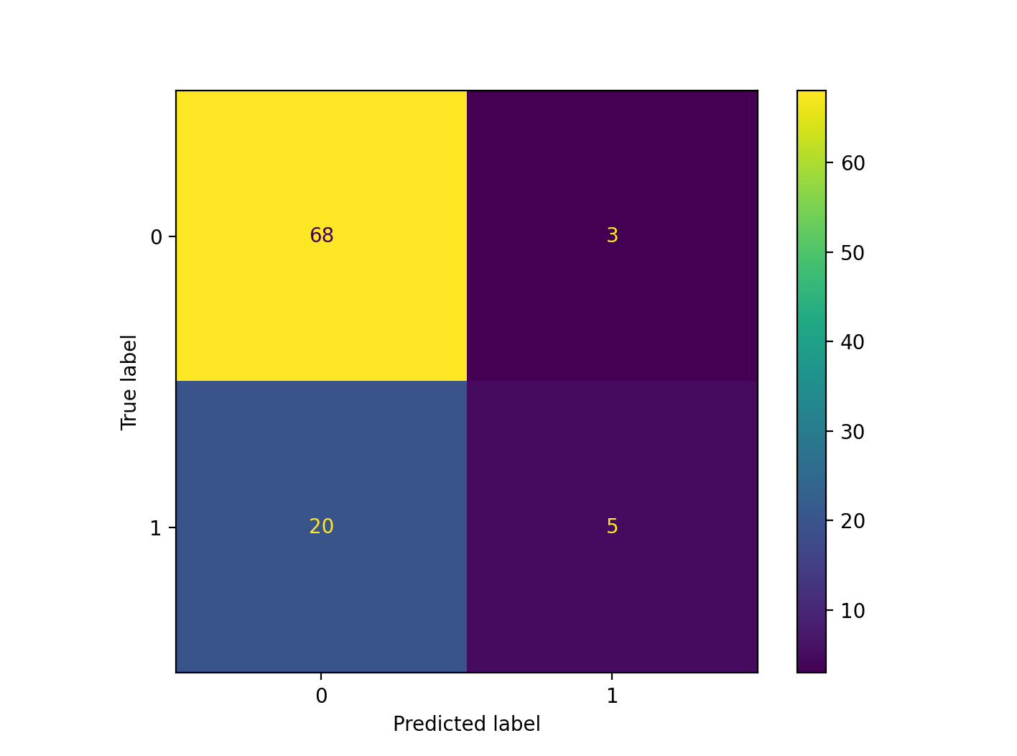
Confusion Matrices Before ADASYN
Param3
Param4
Param1

